Slide 1
SPAN Image Analytics Update for Stage One
Ryan P. Cabeen
March 31, 2021

Slide 2
Analytics Pipeline Overview
IDA
Download
Image Preprocessing
Parameter Estimation
Brain Extraction
Parameter Harmonization
Analytics Report and Visualizations
Aggregate Imaging Metrics
Midline Shift Quantification
Lesion and CSF Segmentation
Atlas Registration

Slide 3
Analytics Pipeline Overview
IDA
Download
Image Preprocessing
Parameter Estimation
Brain Extraction
Parameter Harmonization
New Stuff
Analytics Report and Visualizations
Aggregate Imaging Metrics
Midline Shift Quantification
Lesion and CSF Segmentation
Atlas Registration

Slide 4
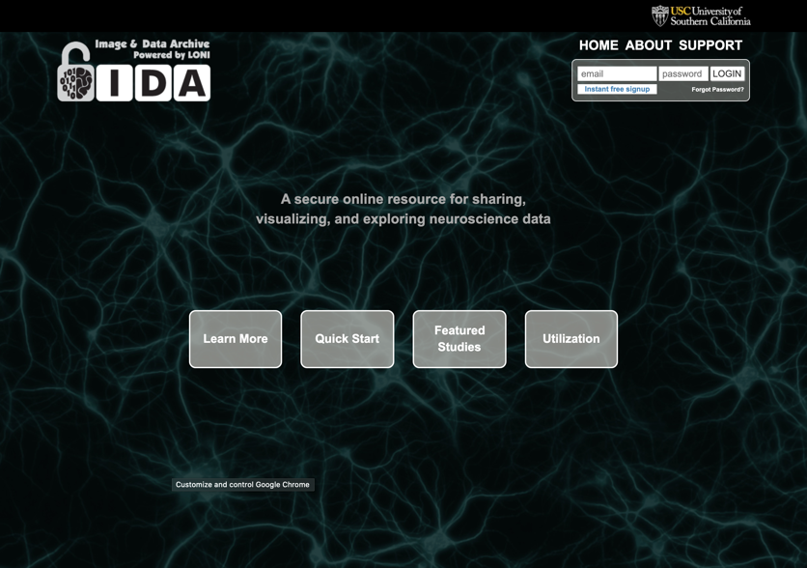
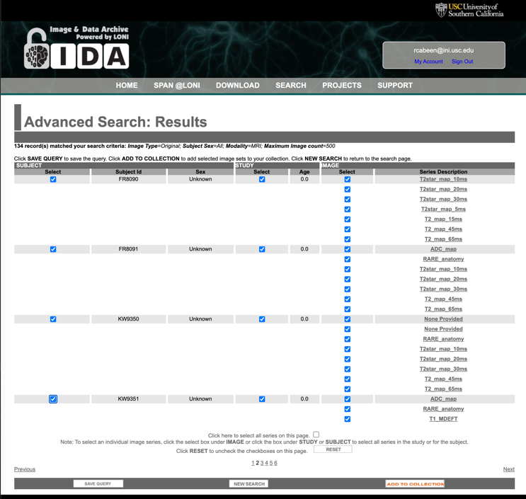
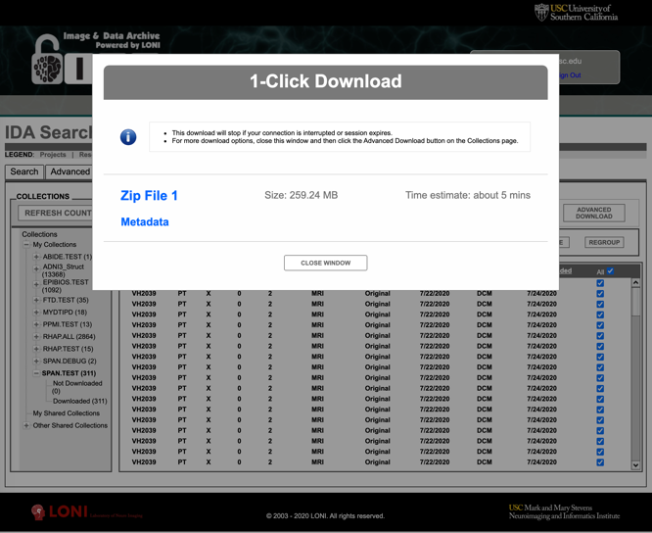
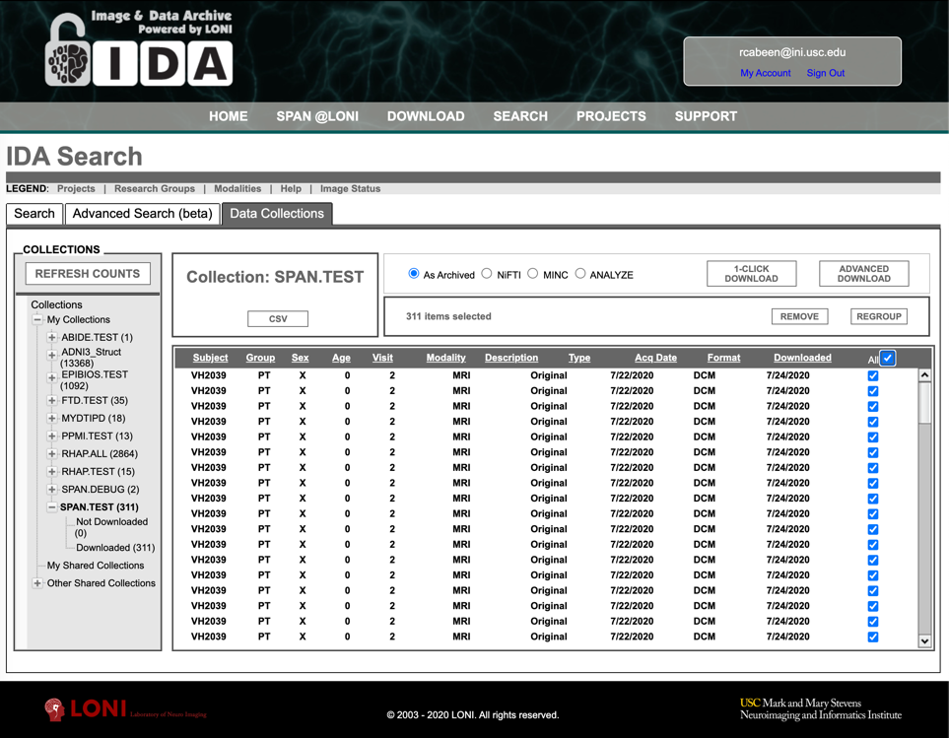
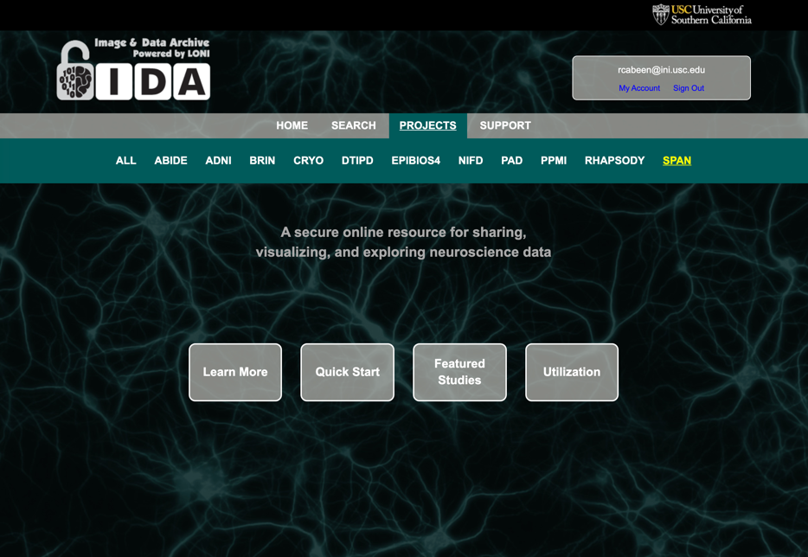
LONI IDA Data Wrangling Process
Download
Query
Login
Next steps…
Collect

Slide 5
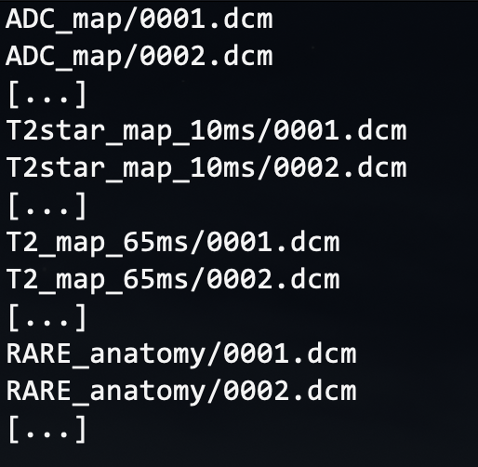
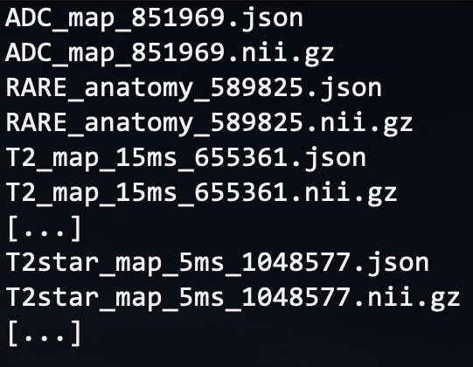
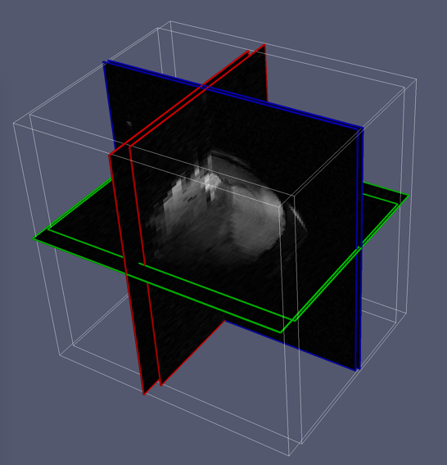
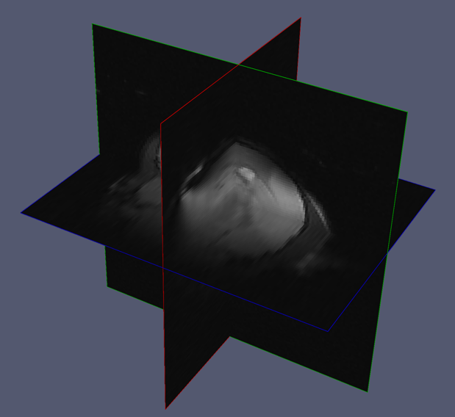
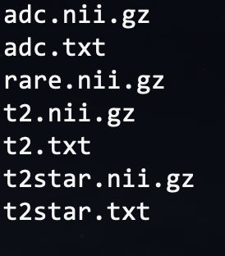
Preprocessing Step: Data Wrangling
File Format Conversion
DICOM to NIfTI
Extract
Meta-data (site & scan parameters)
Harmonize
3D Image orientation and resolution
Collect, Sort and Harmonize Scans
…
(note: DICOM names shortened for clarity)
(some sites use a different FOV within a single session)
(we harmonize the data to remove these differences)

Slide 6
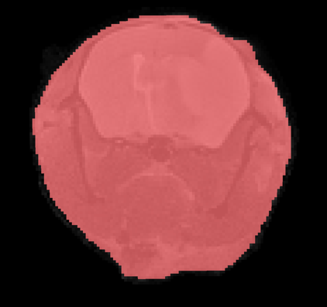
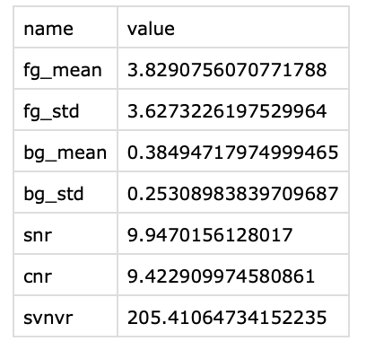
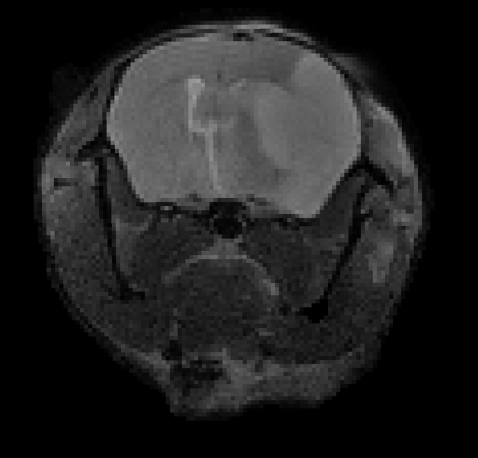
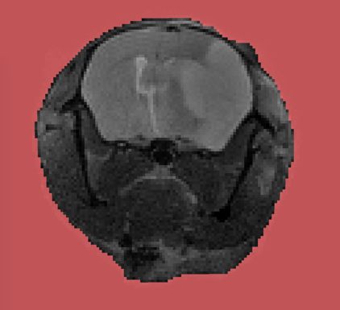
Preprocessing Step: Quality Assessment
Foreground
Metrics
Background
Input Scan
(repeat for ADC, T2, T2-star)
SNR= μ_{FG} / μ_{BG}
CNR= σ_{FG} / μ_{BG}
SVNVR= σ_{FG} / σ_{BG}
Signal Mean (μ) and Std. Deviation (σ) of Foreground (FG) and Background (BG)

Slide 7
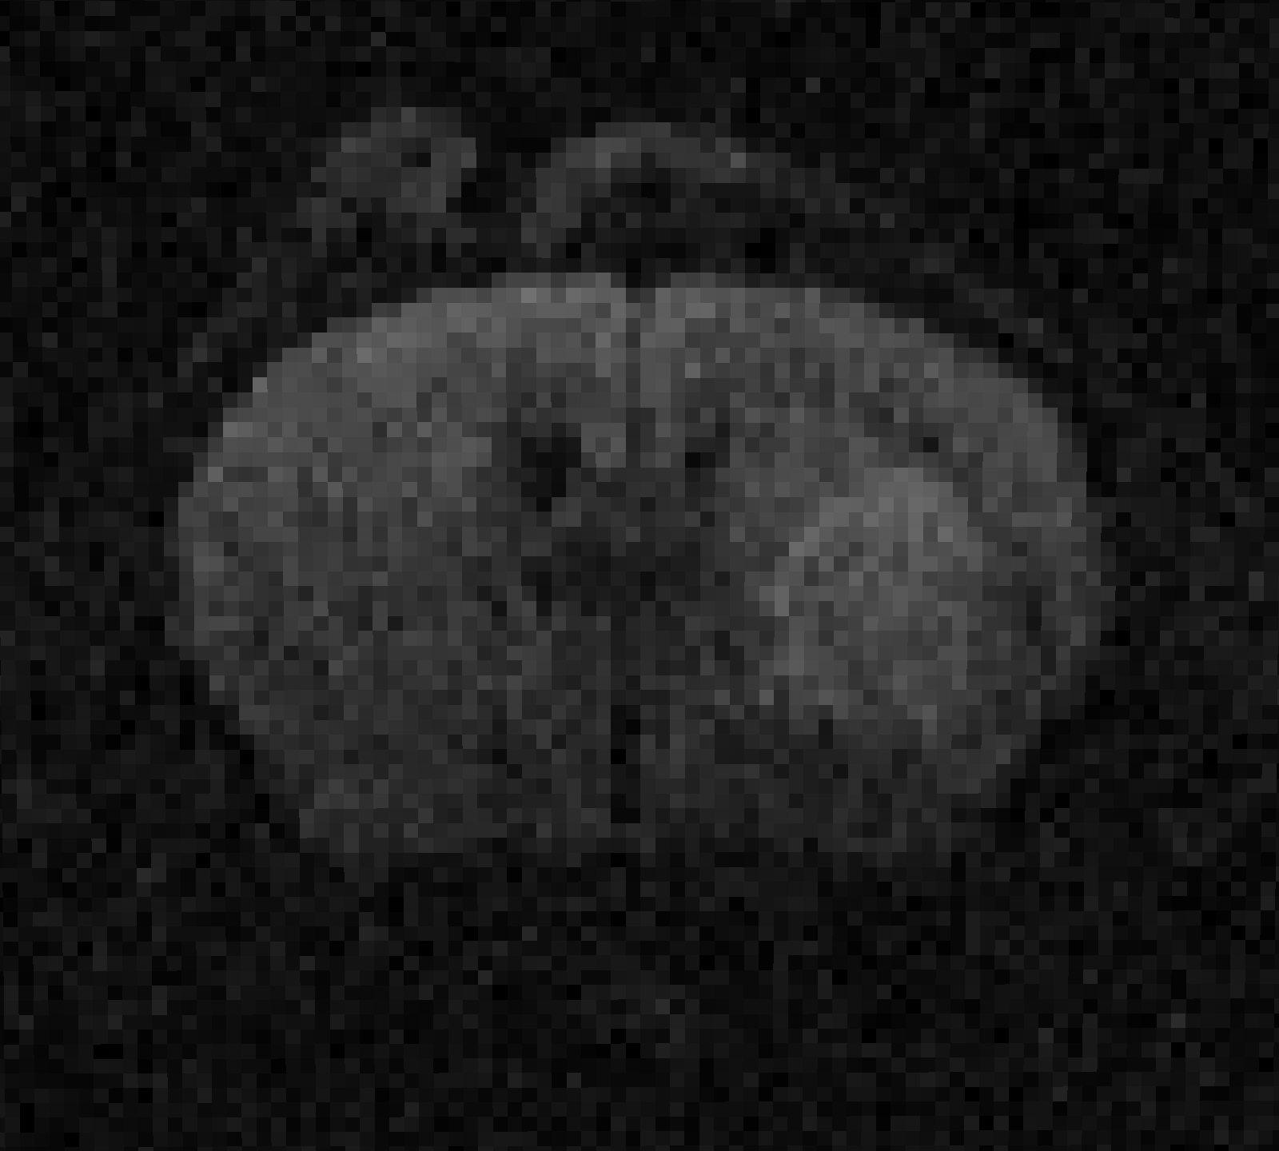
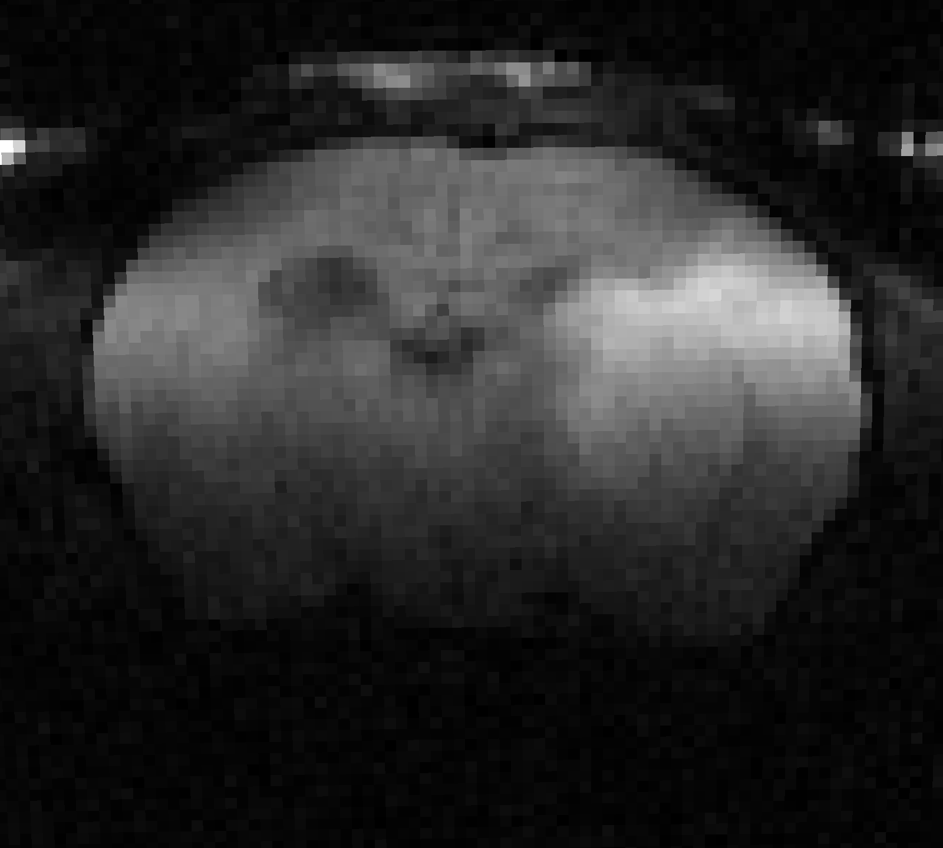
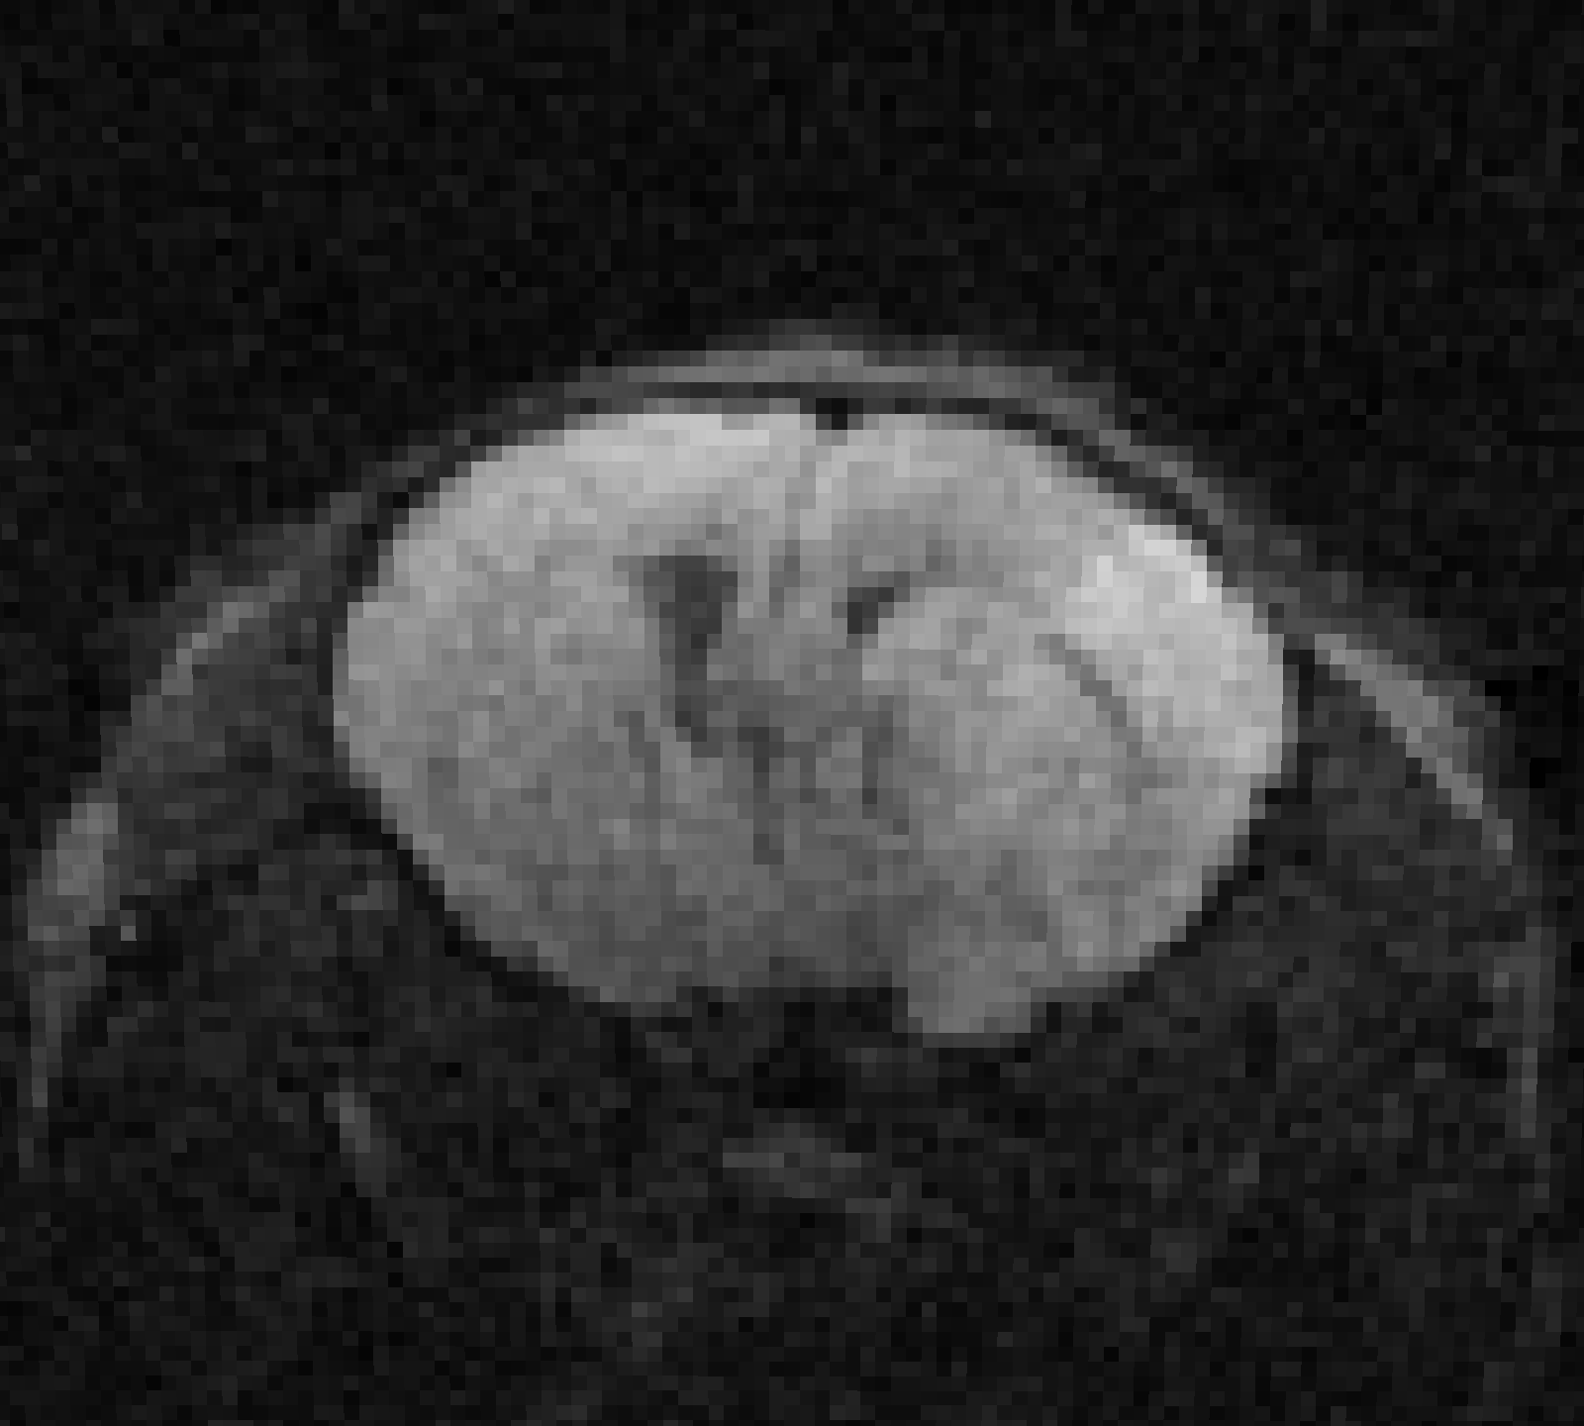
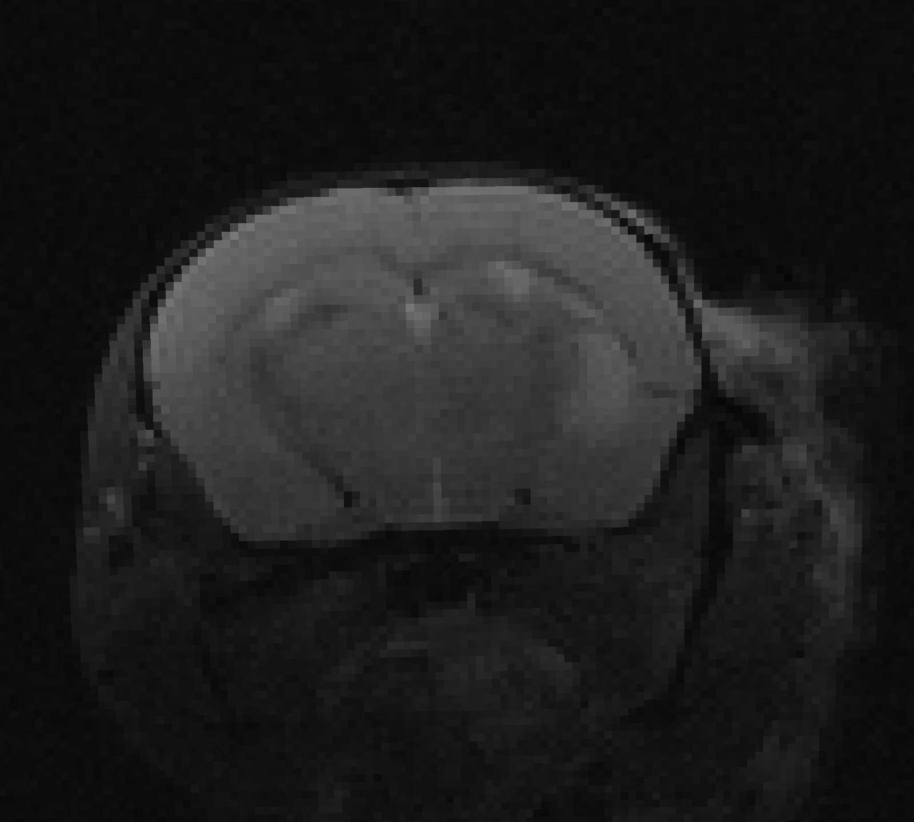
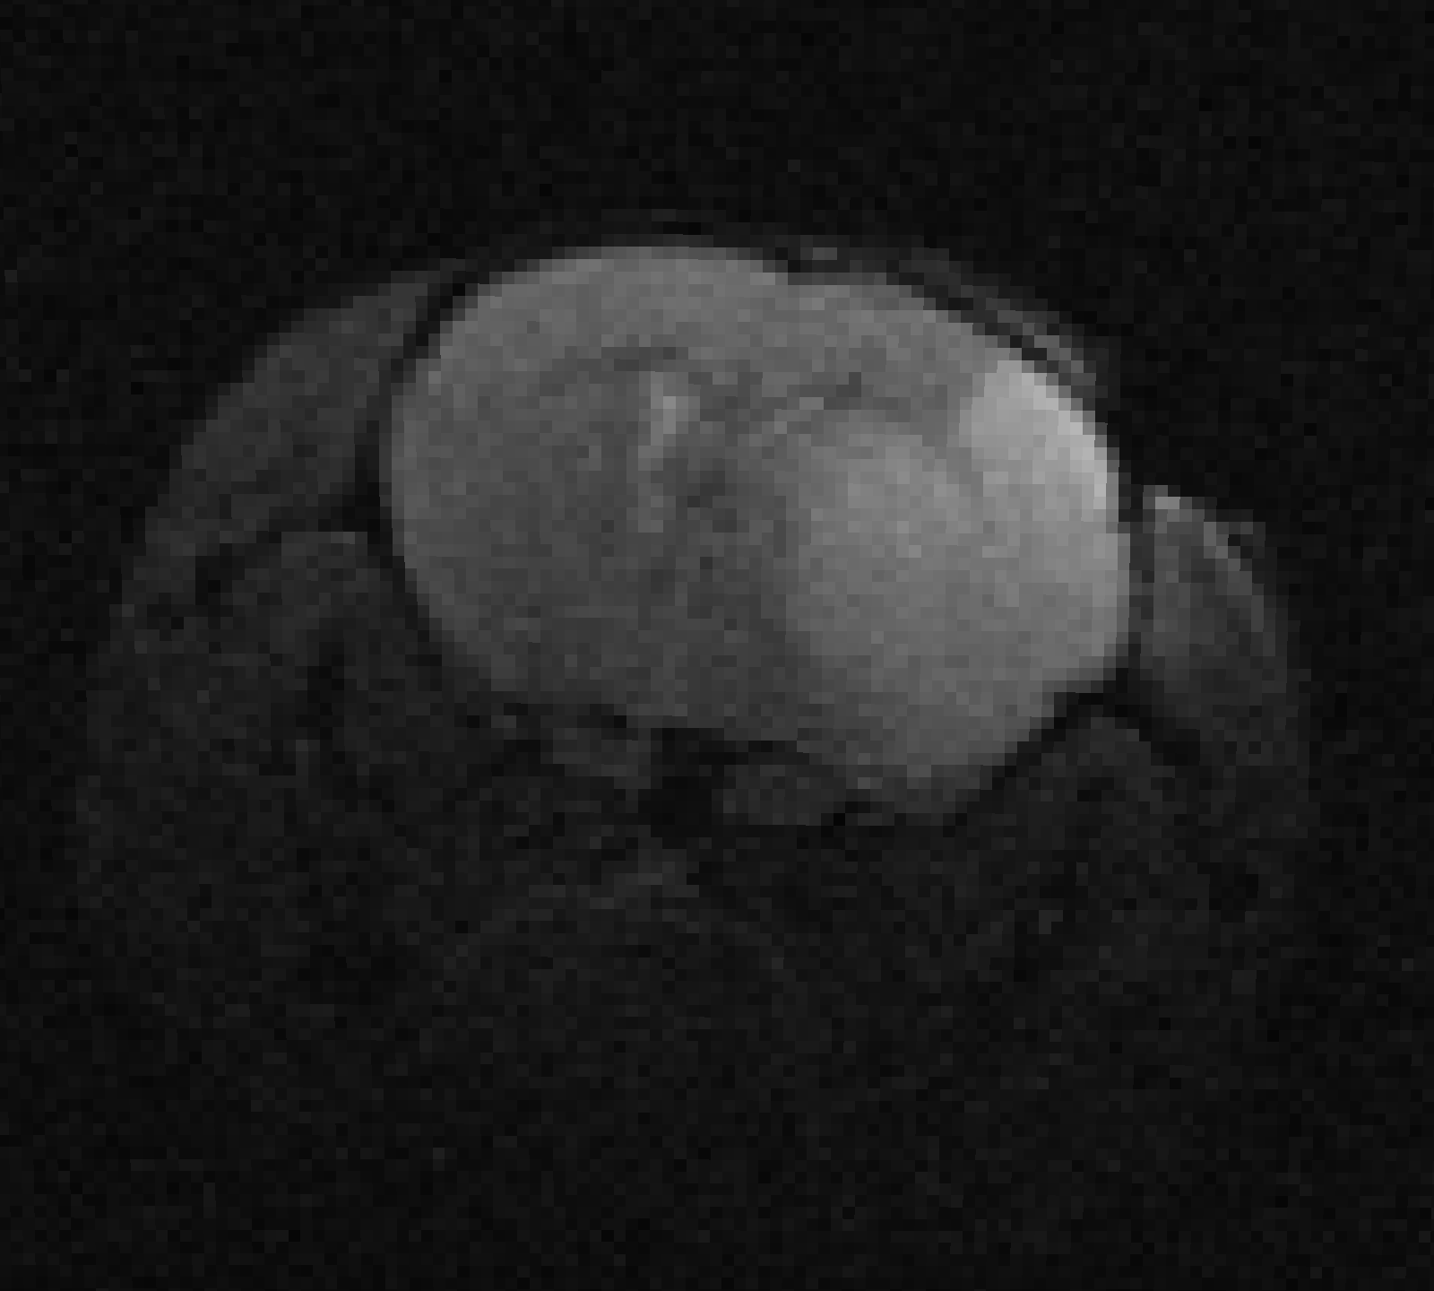
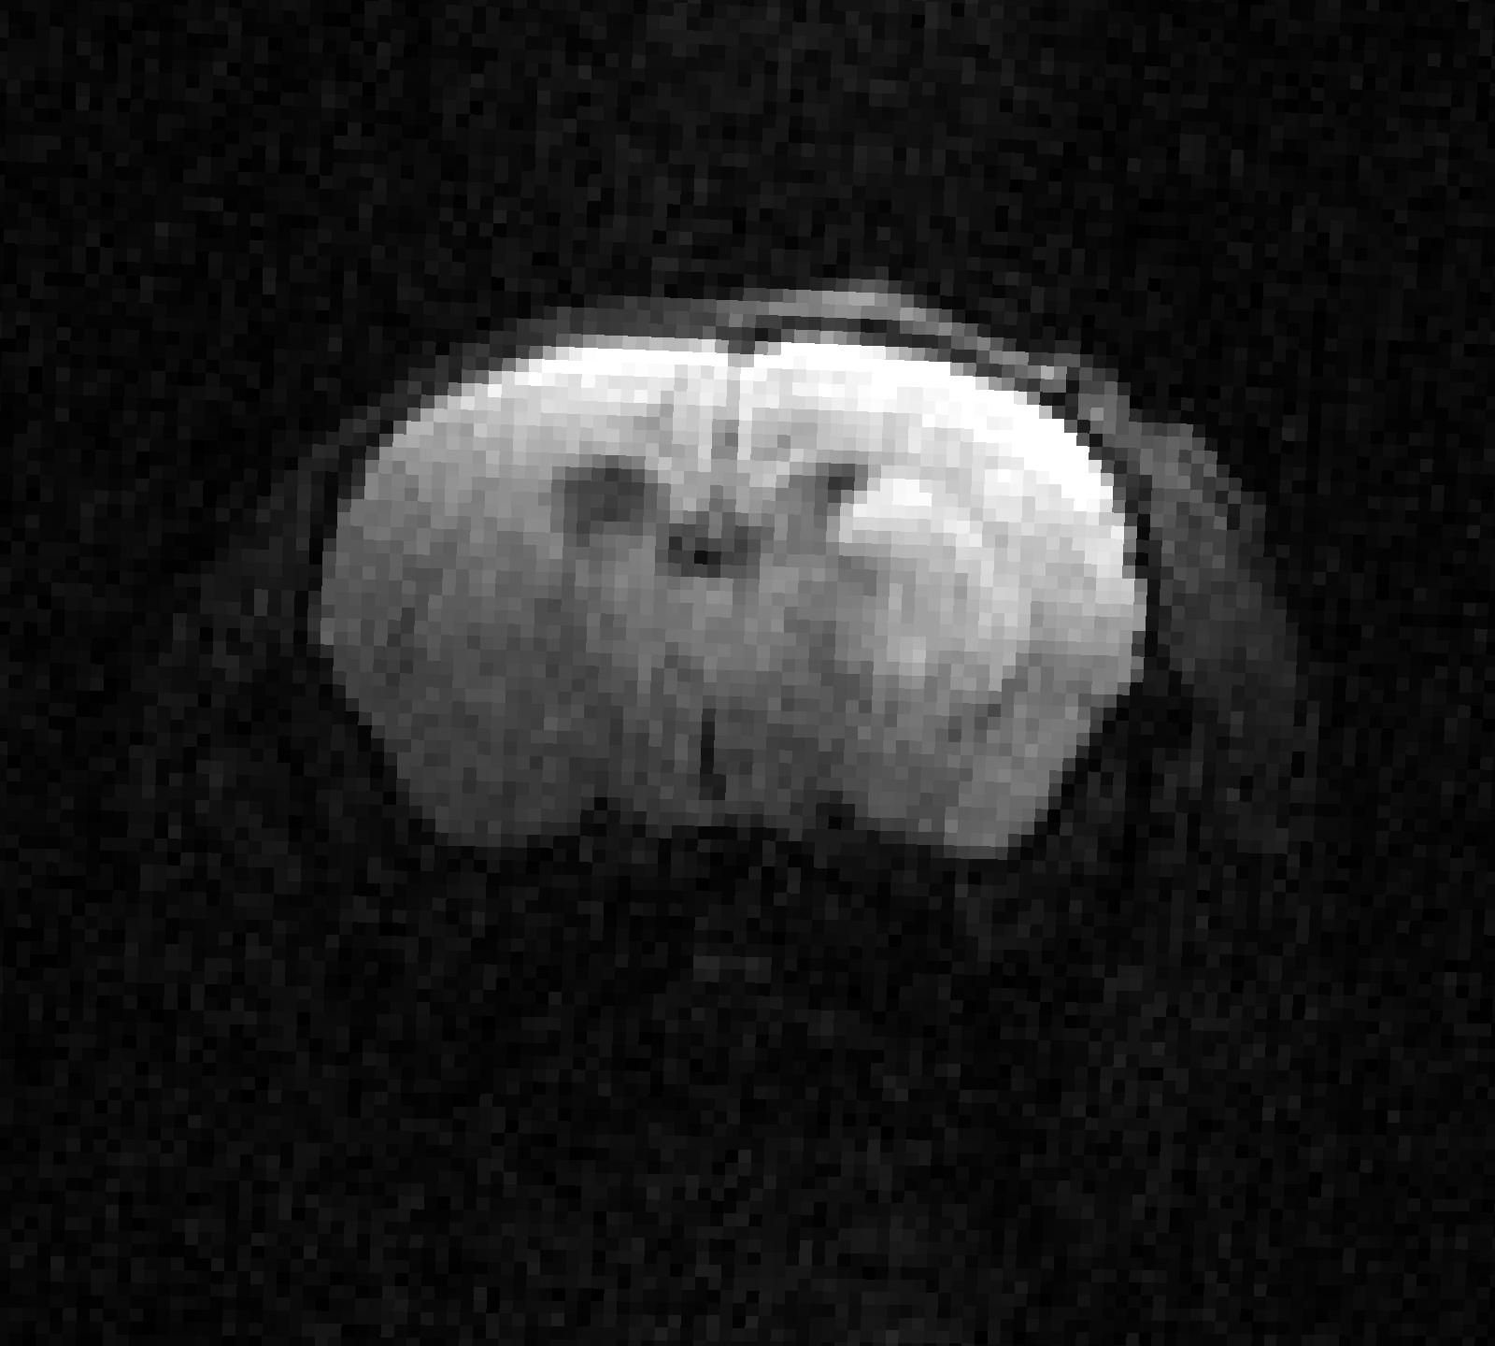






Preprocessing Step: Denoising ADC scans
AG
YL
UI
JH
MG
UT
Approach: Non-local means denoising with local noise estimation, applied to each component scan

Slide 8
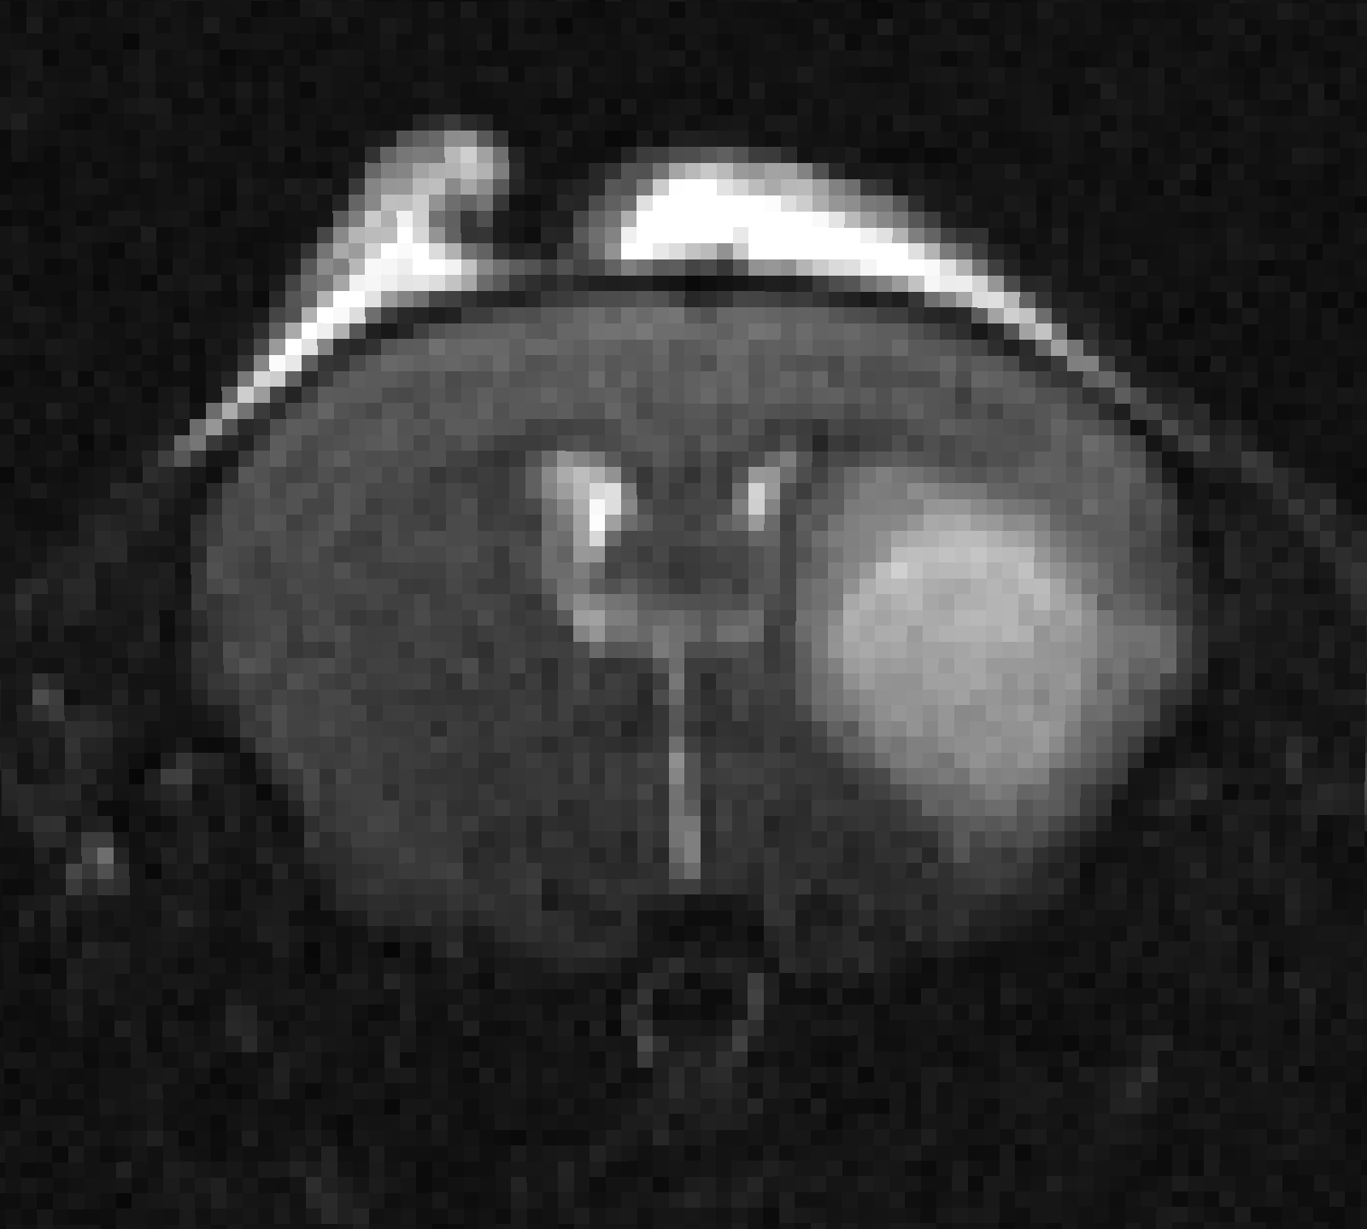
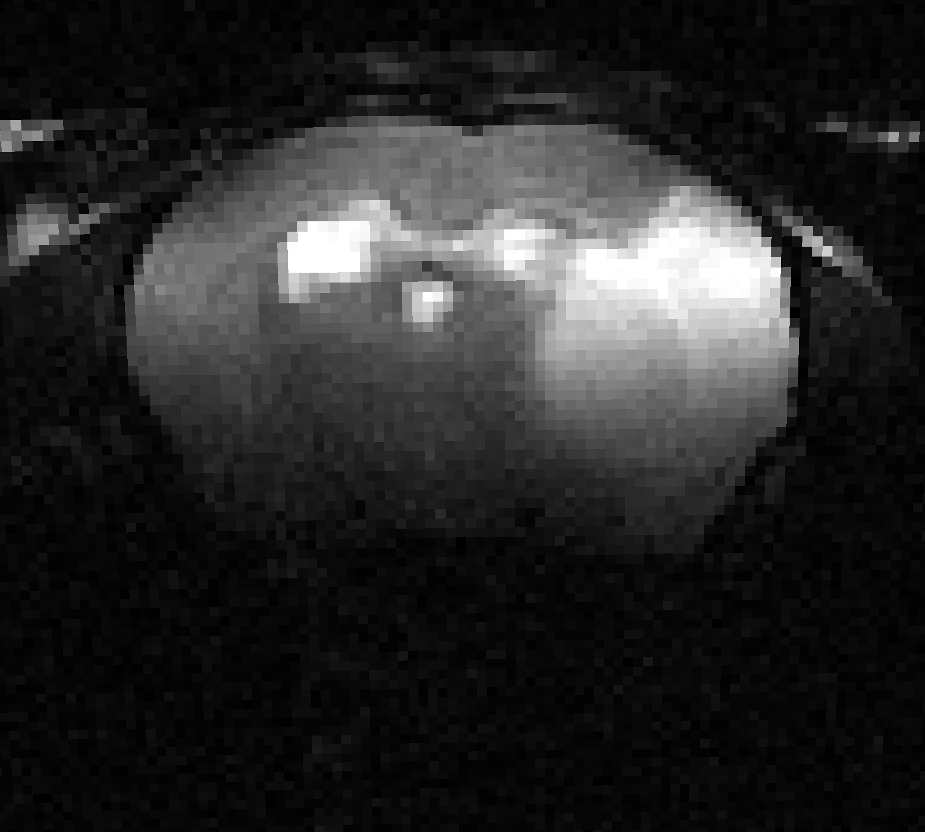
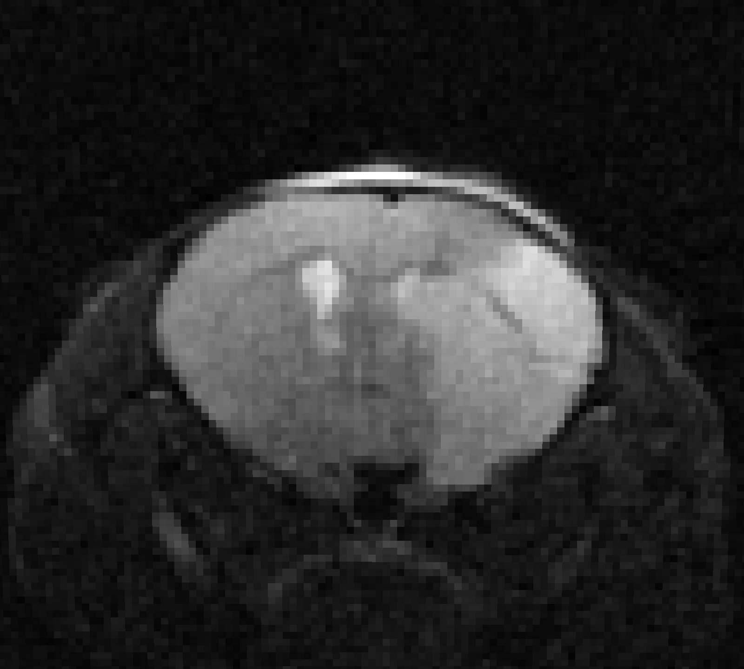
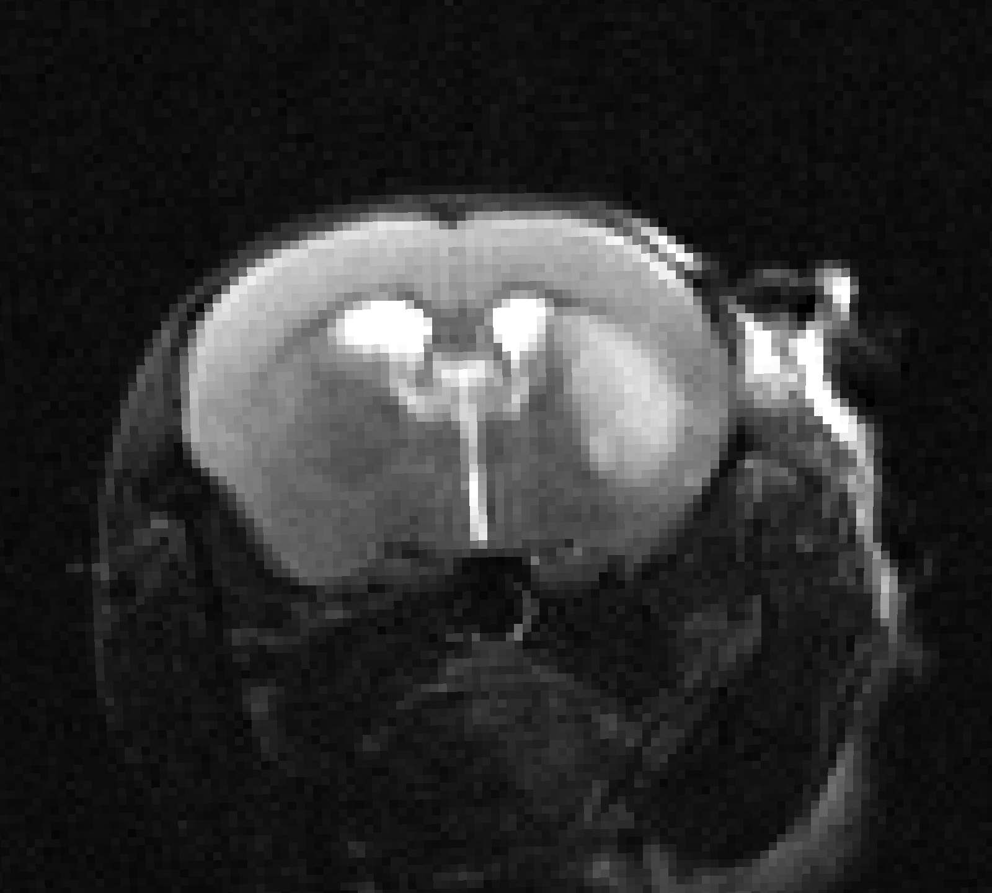
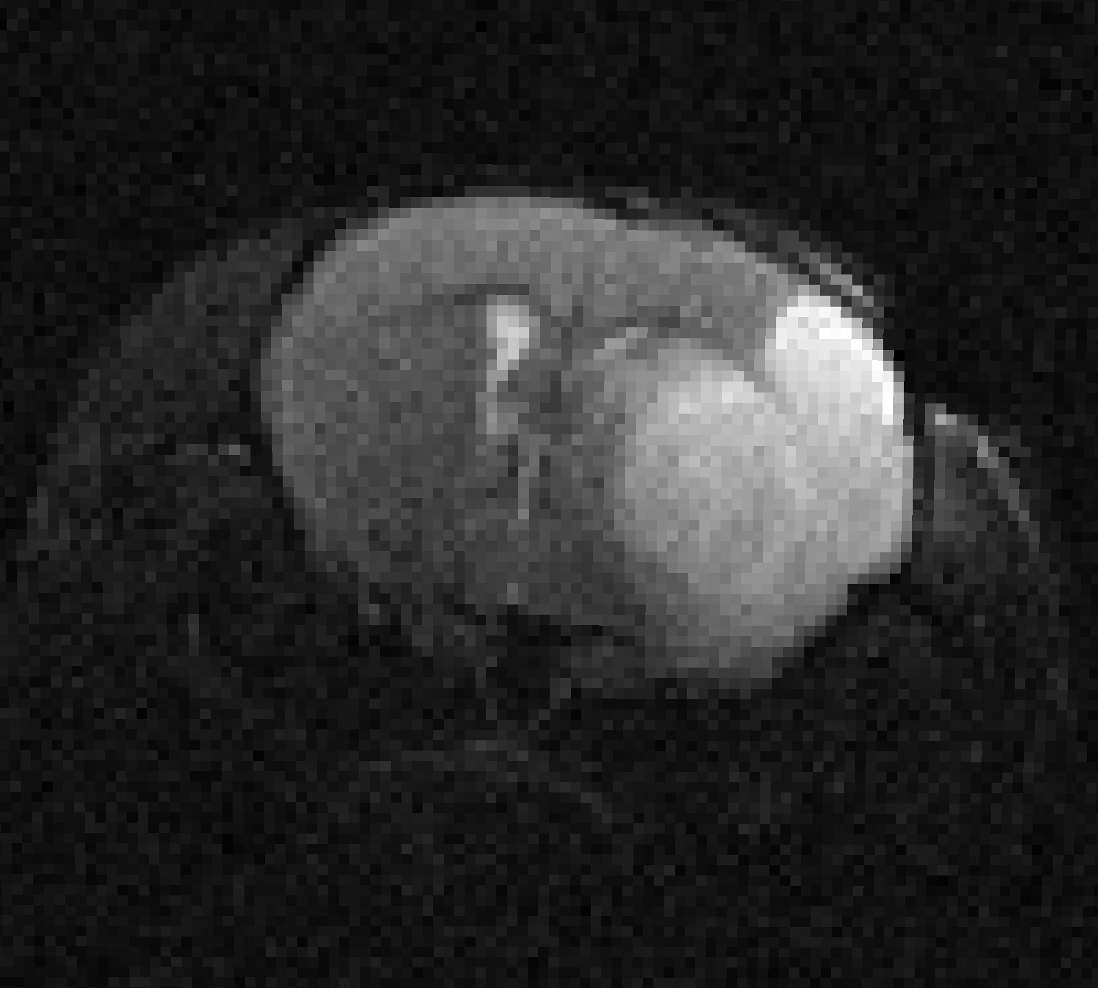
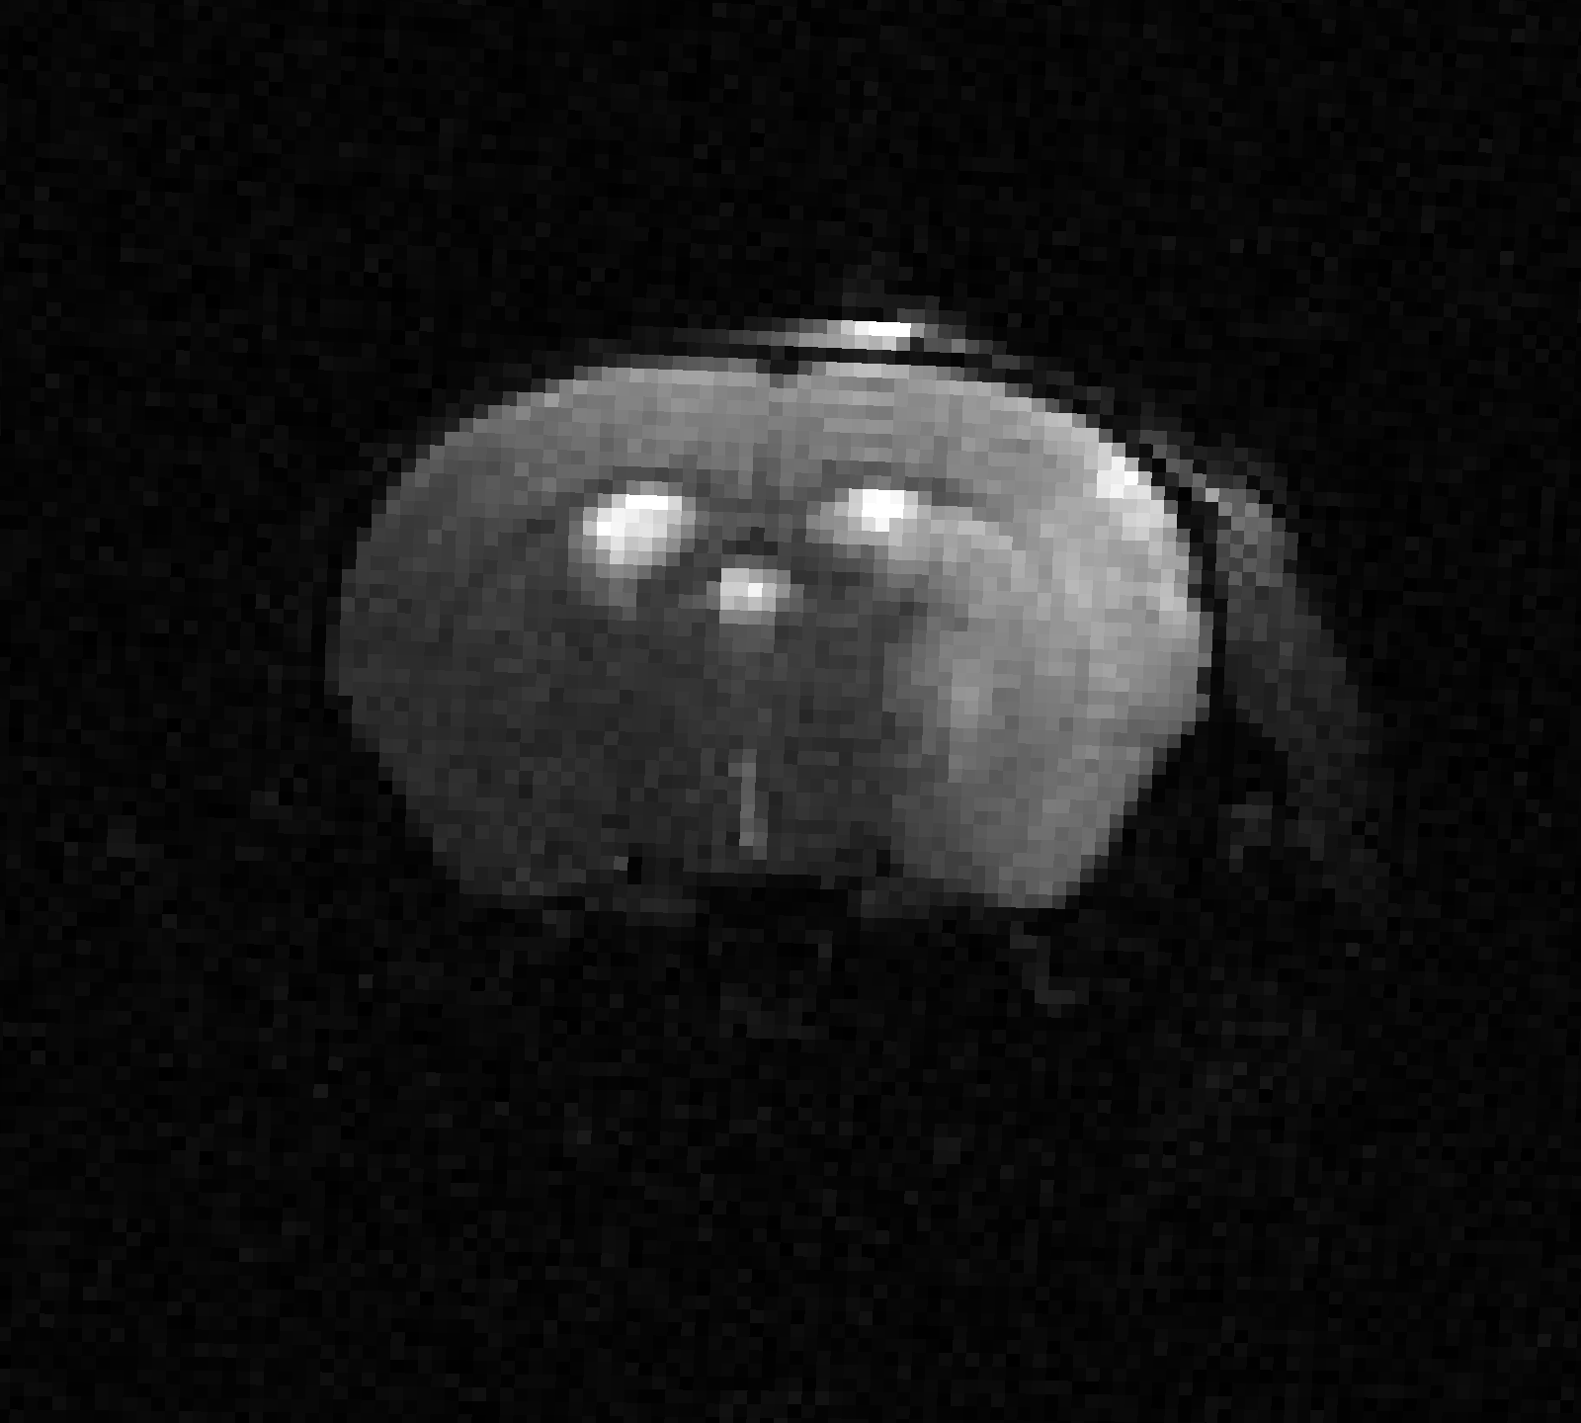






Preprocessing Step: Denoising T2 scans
AG
YL
UI
JH
MG
UT
Approach: Non-local means denoising with local noise estimation, applied to each component scan

Slide 9
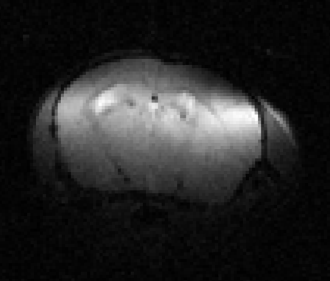
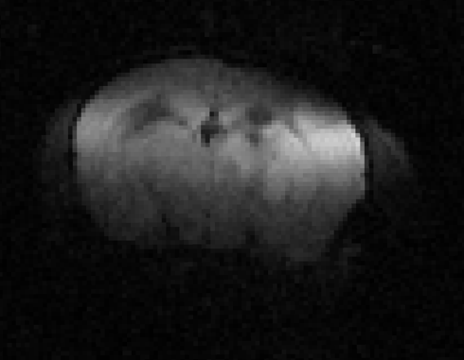
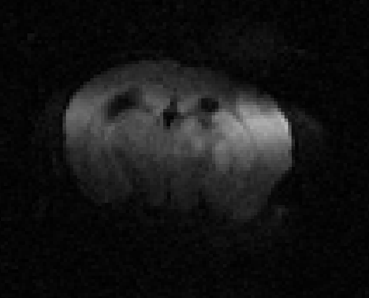
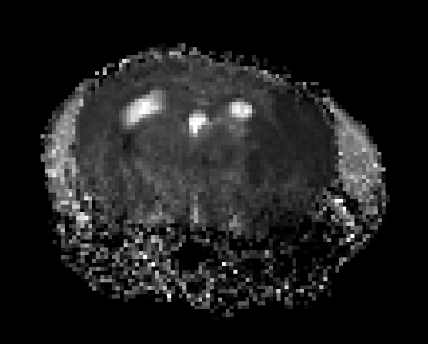
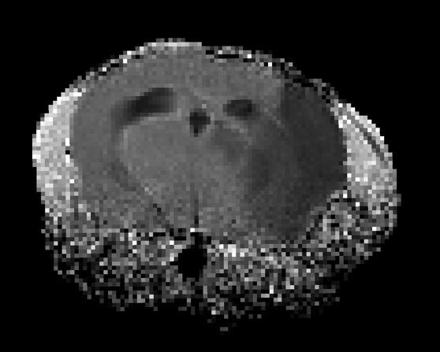
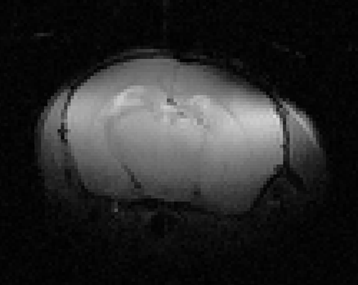
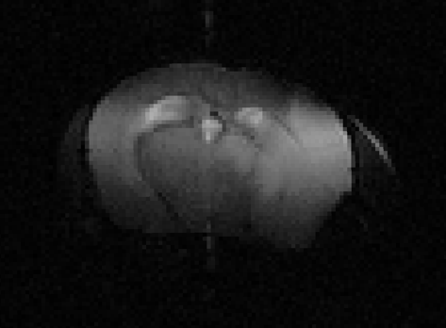
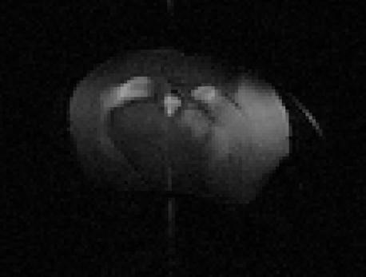
Parameter Estimation
Estimating the Apparent Diffusivity Coefficient (ADC) from multiple b-values
Fitting
b=0 s/mm²
b=500 s/mm²
b=1000 s/mm²
ADC
Estimating the T2 Relaxation Rate from multiple echo times
Fitting
TE=15ms
TE=45ms
TE=60ms
…
T2

Slide 10
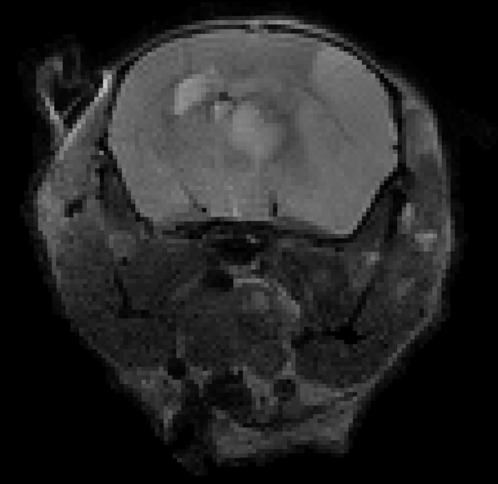
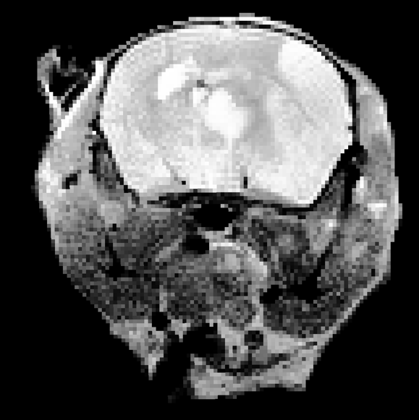
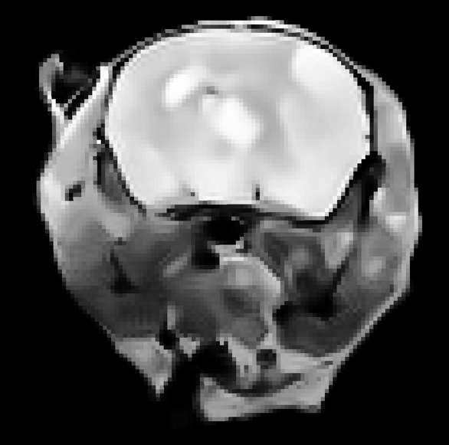
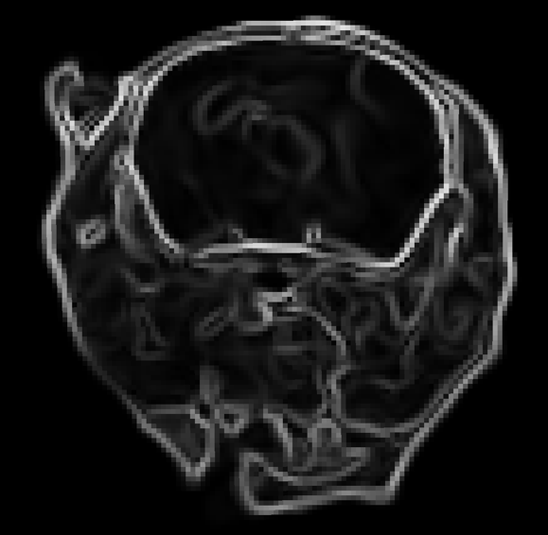
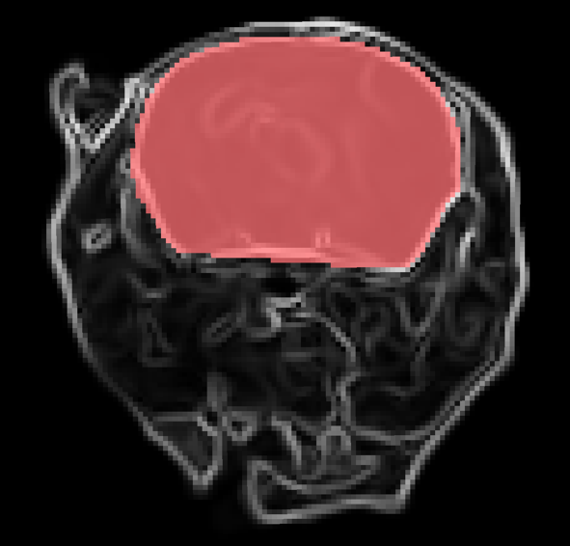
Brain Extraction
Input Scan
Enhanced Contrast
Regularized
Gradients
Brain Segmentation
Approach:
use feature extraction and graph-based segmentation

Slide 11
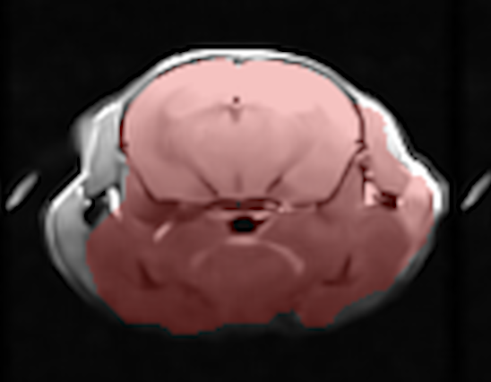
Brain Extraction with Deep Learning Update
Problem:
Our first brain extraction algorithm works well, but with a 5% error rate, due to blurring at skull-brain boundary causing “leaking”, irrespective of site/time

Slide 12

Brain Extraction with Deep Learning Update
Problem:
Our first brain extraction algorithm works well, but with a 5% error rate, due to blurring at skull-brain boundary causing “leaking”, irrespective of site/time
Ronneberger, et al., MICCAI 2015
Solution:
Use a U-net deep learning algorithm:
select the 300 best example results
balanced by site and timepoint,
use them to train, validate, and test
collect and test failure cases

Slide 13
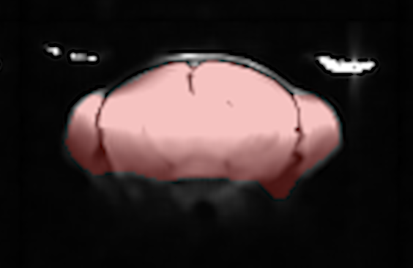
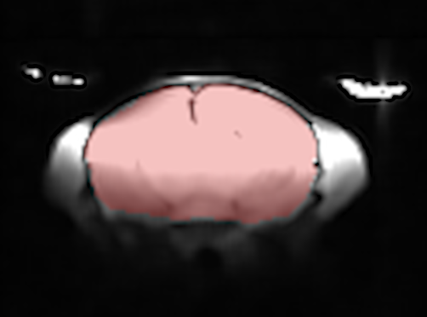
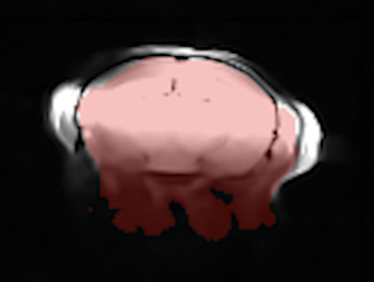
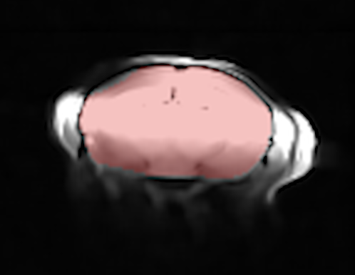
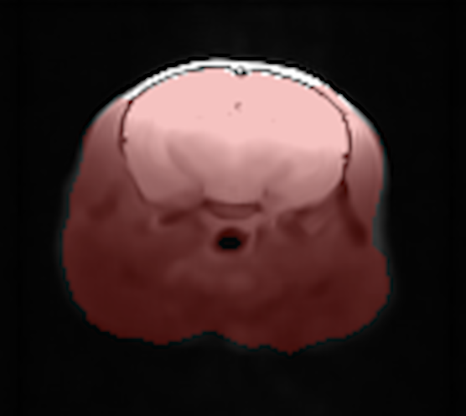
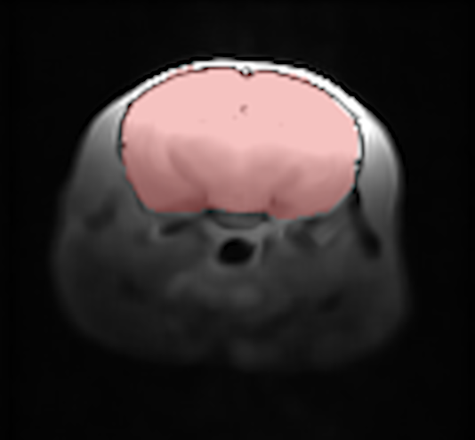
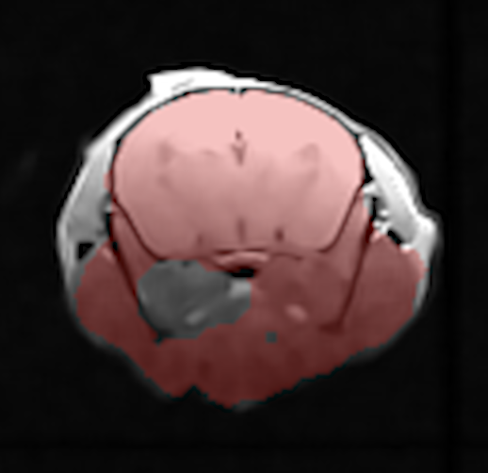
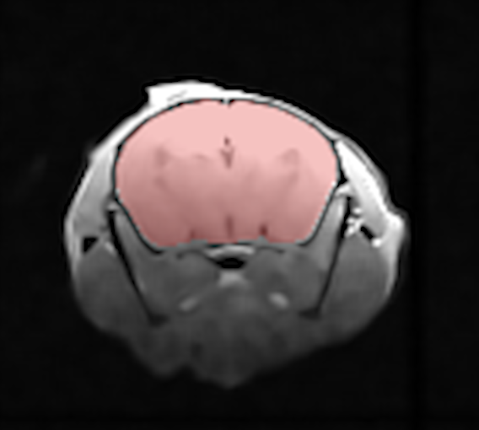
Brain Extraction with Deep Learning Update
Traditional
U-net
Traditional
U-net
Results: Neural network approach accurately reproduces previous approach with 96% accuracy and fixes all failed cases

Slide 14
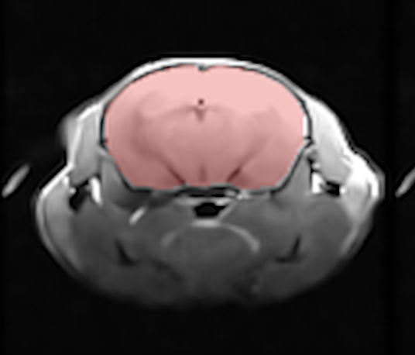
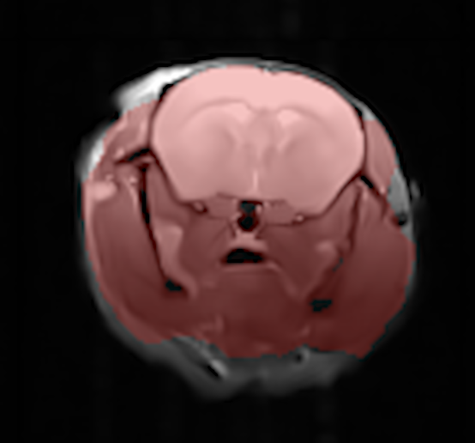





Brain Extraction with Deep Learning Update
Traditional
U-net
Traditional
U-net

Slide 15






Atlas registration
MacKenzie‐Graham, et al. (2007). Epilepsia
BMAT Atlas
Native Space
Atlas
Normalized
Ventricle and Lesion Priors:
Approach: Perform rigid registration to the atlas to preserve morphometry and provide priors (shown on right)

Slide 16


Parameter Harmonization Across Sites

Slide 17





Lesion and CSF Segmentation
T2
Lesion
ADC
CSF
Approach:
Lesion is low R2 & low ADC,
CSF is low R2 & high ADC.
Rest is normal appearing tissue

Slide 18


Midline shift quantification
CSF
CSF
Approach:
Select thin coronal section of ventricles based on atlas
Compute centroid and left-right extreme points
Measure absolute and relative measures of brain shift
Segment left and right hemisphere (assuming a parabolic surface)

Slide 19



Analytics and Report Generation
Summary metrics:
Image quality
Lesion, CSF, and tissue volume
Mid-line shift index
Per-hemisphere tissue volumes
Intra-cranial volume
Others are possible…
Visualizations:
Mosaic plots of images
Overlays of segmentations
3D models

Slide 20


Summarizing the entire dataset
1309 scans uploaded to IDA
779 early timepoint, 530 late
13 failed due to incomplete data
25 failed due to motion

Slide 21
Visualizing Stage One

Slide 22


Slide 23


